Slide 1
FUZZY LOGIC
BY Bibek Karki(191613)
and Rakesh Rai(191630)
Reviewed BY:
Munna Kumar Chaudhary
Unique Adhikari
Himal Basnet
Able Gurung

Slide 2
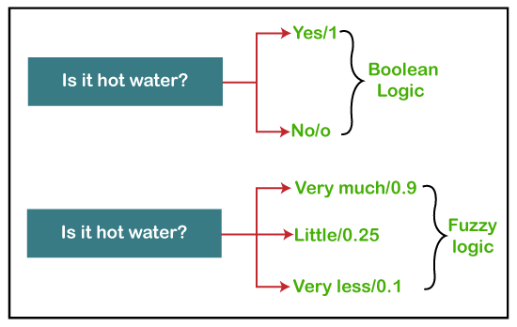
INTRODUCTION
Extends traditional boolean logic.
Represents uncertainty
Reasoning with imprecision.
Allows flexible decision-making
Useful in various fields.

Slide 3
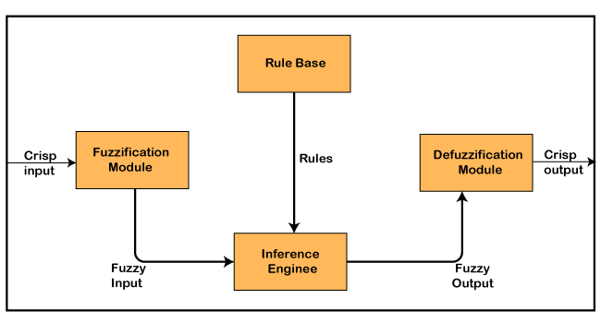
FUZZY SYSTEM ARCHITECTURE

Slide 4

FUZZY SET
Set having degrees of membership between 1 and 0.
Represented with tilde character(~).
Mathematically,a fuzzy set Ã is defined as a pair of (U, M),

Slide 5
UNIVERSITY OF DISCOURSE {U}
known as the domain or set of all possible elements
can also be denoted by Ω or X.

Slide 6
MEMBERSHIP FUNCTION {M}
assigns a degree of membership to each element in the universe of discourse
For the Fuzzy set B, the membership function for X is defined as:
μB:X → [0,1]
In this function X, each element of set B is mapped to the value between 0 and 1
This is called a degree of membership or membership value.

Slide 7
OPERATIONS ON FUZZY SET
Given ~A and ~B are two fuzzy sets and X is the universe of discourse, with respective membership functions:
μ_{A}(x), μ_{B}(x)
The operations of Fuzzy set are as follows:
Union operation
Intersection operation
Complement operation

Slide 8
UNION OPERATION
Mathematically represented as μ_{A∪B}(x) = max (μ_{A}(x), μ_{B}(x))
Here let , A = {( X₁, 0.6 ), (X₂, 0.2), (X₃, 1), (X₄, 0.4)}
B = {( X₁, 0.1), (X₂, 0.8), (X₃, 0), (X₄, 0.9)}
Then, AUB = {( X₁, 0.6), (X₂, 0.8), (X₃, 1), (X₄, 0.9)}

Slide 9
UNION OPERATION
For X₁ For X₂ For X₃
μ_{A∪B}(X₁) = max (μ_{A}(X₁), μ_{B}(X₁)) μ_{A∪B}(X₂) = max (μ_{A}(X₂), μ_{B}(X₂)) μ_{A∪B}(X₃) = max (μ_{A}(X₃), μ_{B}(X₃))
μ_{A∪B}(X₁) = max (0.6, 0.1) μ_{A∪B}(X₂) = max (0.7, 0.2) μ_{A∪B}(X₃) = max (1, 0)
μ_{A∪B}(X₁) = 0.6 μ_{A∪B}(X₂) = 0.2 μ_{A∪B}(X₃) = 1
For X₄
μ_{A∪B}(X₄) = max (μ_{A}(X₄), μ_{B}(X₄))
μ_{A∪B}(X₄) = max (0.4, 0.9)
μ_{A∪B}(X₄) = 0.9

Slide 10
INTERSECTION OPERATION
Mathematically represented as μ_{A∩B}(x) = min (μ_{A}(x), μ_{B}(x))
Let , A = {( X₁, 0.3 ), (X₂, 0.7), (X₃, 0.5), (X₄, 0.1)}
B = {( X₁, 0.8), (X₂, 0.2), (X₃, 0.4), (X₄, 0.9)}
Then , A∩B = {( X₁, 0.3), (X₂, 0.2), (X₃, 0.4), (X₄, 0.1)}

Slide 11
COMPLEMENT OPERATION
Mathematically represented as μ_{Ā}(x) = 1-μ_{A}(x)
Let, A = {( X₁, 0.3 ), (X₂, 0.8), (X₃, 0.5), (X₄, 0.1)}
Then, Ā= {( X₁, 0.7 ), (X₂, 0.2), (X₃, 0.5), (X₄, 0.9)}

Slide 12
ADVANTAGES
Human like reasoning
Easy to understand
Widely applicable
Simple mathematical foundation
Low memory requirements
Control machines and consumer products

Slide 13
DISADVANTAGES
Slow run time
Difficulty in understanding
Lack of accuracy
Ambiguity
Limited accuracy
High testing requirements

Slide 14
APPLICATIONS
Used to improve the understanding of natural language text by a computer.
Used to design intelligent systems that can make decisions based on uncertain or imprecise information.
Used to control the behavior of robots in uncertain environments.
"Fuzzy Logic: Improving Decisions, Control, AI"

Slide 15
REFERENCES
JAVATPOINT,https://www.javatpoint.com/fuzzy-logic
GEEKSFORGEEKS,https://www.geeksforgeeks.org/fuzzy-logic-introduction/
YOUTUBE,https://youtu.be/vof2vhfqoBo
CHATGPT,https://chat.openai.com/chat

Slide 16
THANK YOU

